Slide 1
Getting Data In and Out of R Quickly and Easily
Jake Tolbert

Slide 2
Getting Data Into R
Yeah, mtcars is cool, but it ain"t gonna tell me who"ll donate this year.

Slide 3
Basic Object Assignment
"object" = "variable" = every kind of data
Assign objects with <- like this
a_value <- 2 + 2
another_value <- a_value + 8
a_vector_of_values <- c(10,20,500,1000)
mydata <- read.csv("myspreadsheet.csv")

Slide 4
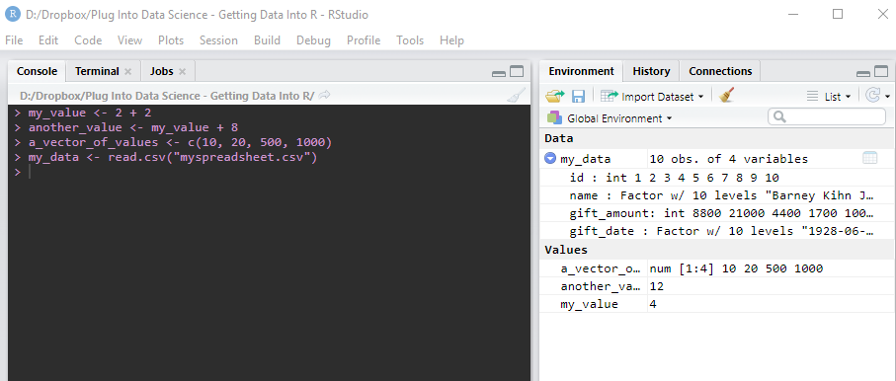
Basic Object Assignment
Use the Environment Pane to see what"s assigned

Slide 5
Getting Data In
Use the readr package
Mostly read_csv() like this
library(readr)
mydata <- read_csv("a-csv-file-on-my-computer.csv")
It"s fast and straightforward
Tries to guess correct formats for each column

Slide 6
Getting Data In
Excel Files? No problem
Use readxl::read_excel
library(readxl)
an_excel <- read_excel("fancy-file.xlsx", 1)
Still lots of guessing

Slide 7
Getting Data In
Hate guessing? Like getting angry?
Use read.csv()
an_excel <- read.csv("a-csv-file-on-my-computer.csv")
No guessing
But stringsAsFactors = T by default is gonna crush your soul.

Slide 8
Getting Data In
Got reports but not database access?
Always put them in the same place and use read_csv().
Write a snippet to read your files in every time.

Slide 9
Getting Data In
For every day use—read from the clipboard!
Copy some cells in excel
In R, do this:
newdata <- read.csv("clipboard", sep = "\t")
Profit!

Slide 10
Getting Data Out
For every day use—write back to the clipboard!
write.table(newdata, "clipboard", sep = "\t")
Then go paste that in Excel!

Slide 11
Getting Data Out
For serious use, use write_csv()
write_csv(mtcars, "mtcars-as-file.csv")
(Don"t send this to your VP! It"s ugly!)

Slide 12
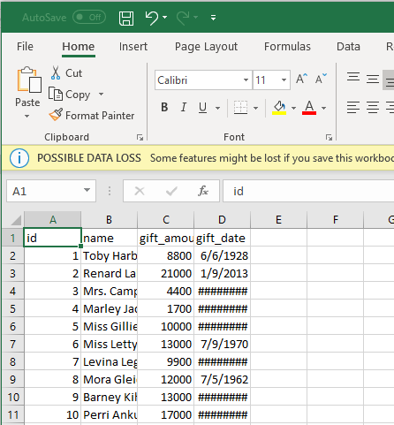
Getting Data Out
Don"t send that csv
file to your VP!
It"s ugly!

Slide 13
Getting Data Out
No good way to write to formatted Excel (yet)
Writing to a database is possible, but clunky

Slide 14
Script, Slides & Data
I put all of the things up on Github. Go and clone that repo to play around.
https://github.com/crazybilly/getting-data-in-out-of-R
Other useful functions in muadc package
read.tidy()
write.tidy()
write.clip() and its fancy excel = T argument!

Slide 15
Questions?

